Slide 1
PROJECT
Submitted By:
Saurabh Parab
Tej Patel
Kailash Kumar
Batch: PGDA-09

Slide 2
Objective
The main objective is to predict the probability of default, whether the customer will default the loan or not by using the past data.
That means, given a set of new predictor variables, we need to predict the target variable as 1 -> Defaulter or 0 -> Non-Defaulter.
Dataset Description: Contains 855969 rows and 73 columns

Slide 3
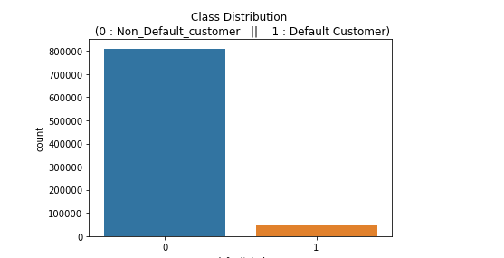
Exploratory Data Analysis:
Plot showing the count of the Default
customers and Non-default customers in ‘default_ind’ variable.

Slide 4
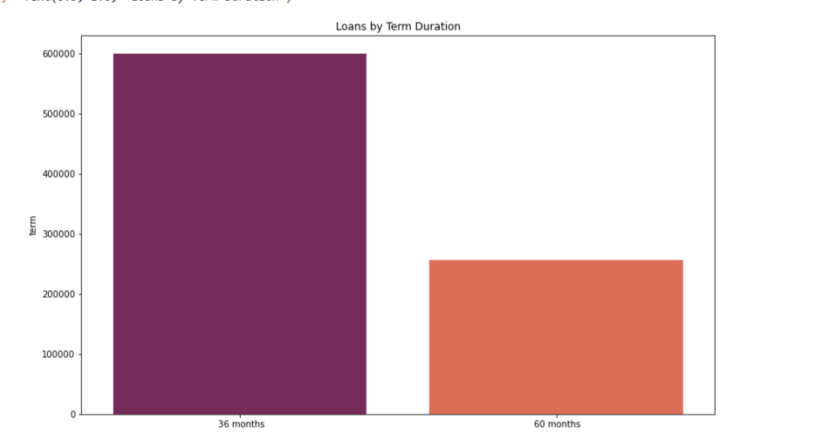
Exploratory Data Analysis:
Plot showing the distribution of ‘term’ variable.

Slide 5
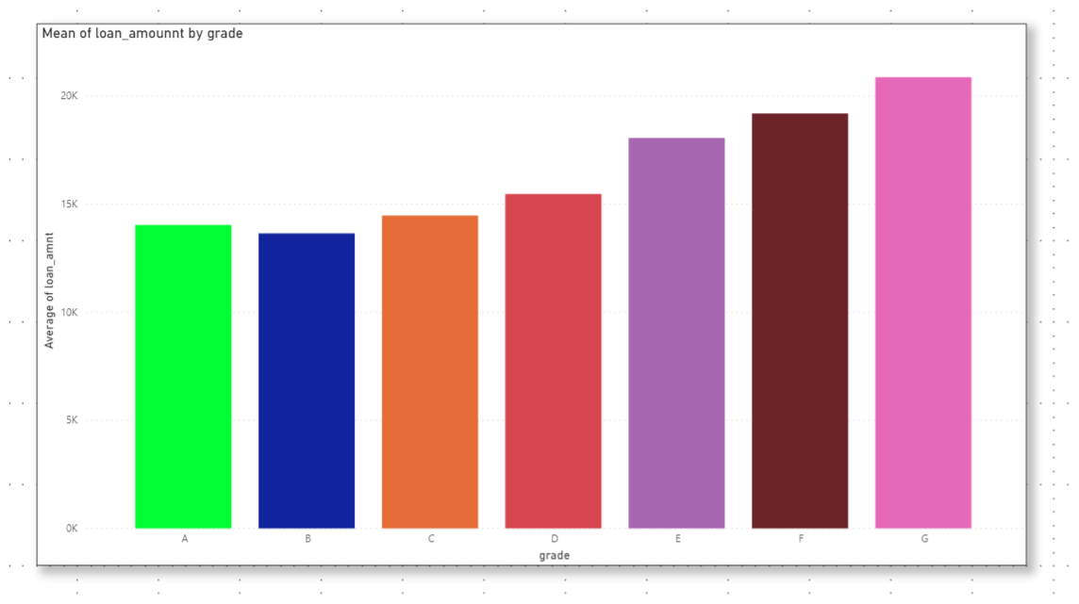
Exploratory Data Analysis:
Plot showing the Grade Count.

Slide 6
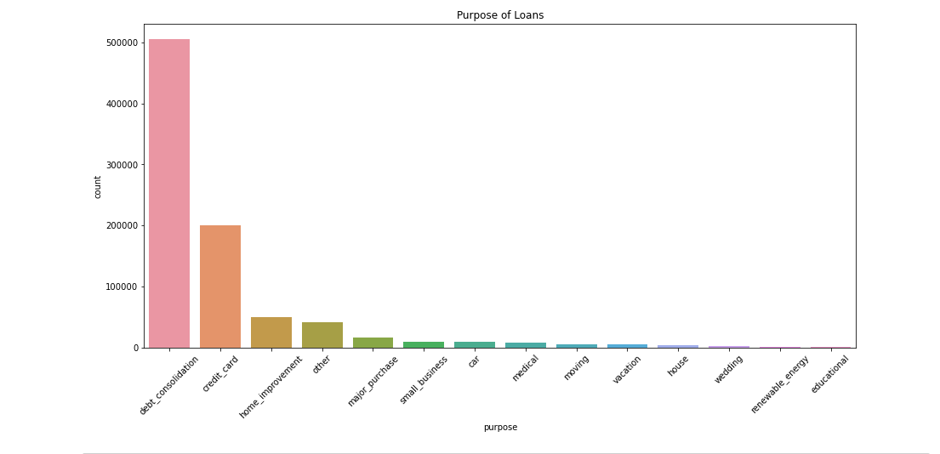
Exploratory Data Analysis:
Plot showing the purpose for which the loan was taken by every individual.

Slide 7
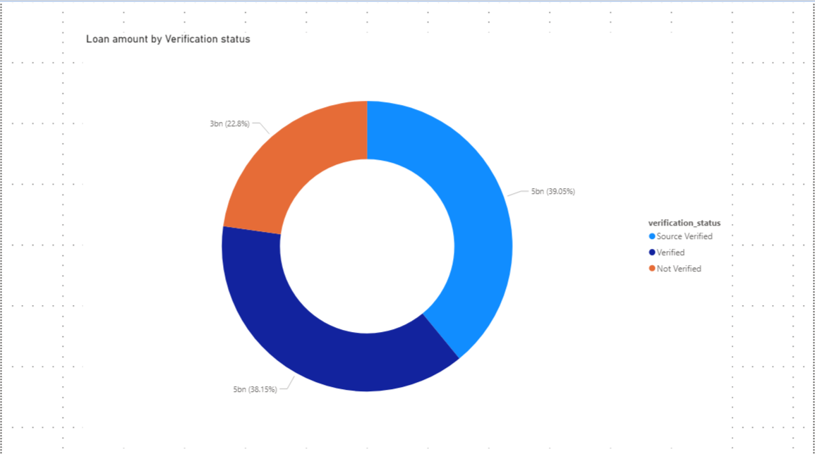
Exploratory Data Analysis:
Plot showing Loan amount by verification status.

Slide 8
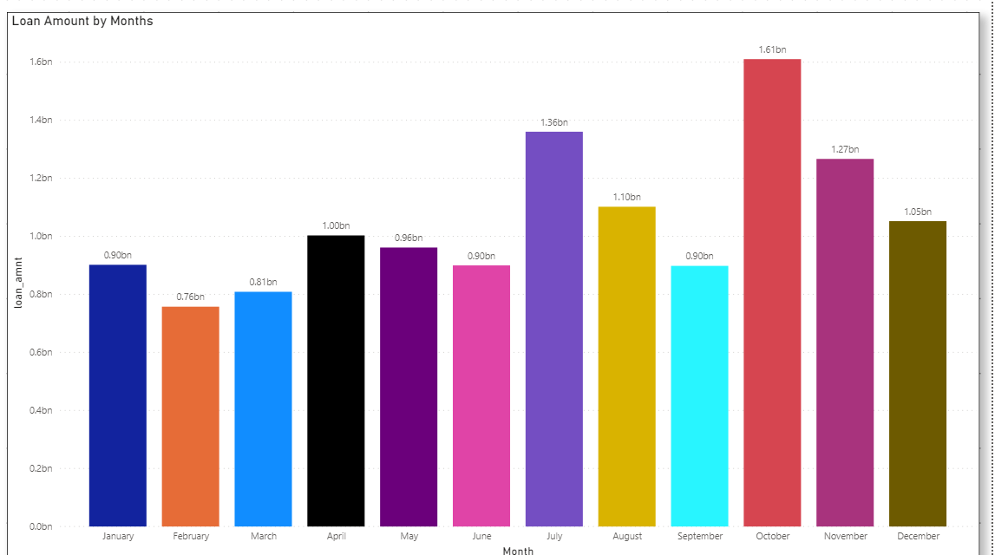
Exploratory Data Analysis:
Plot showing the issue date in year and month of the loan amount.

Slide 9
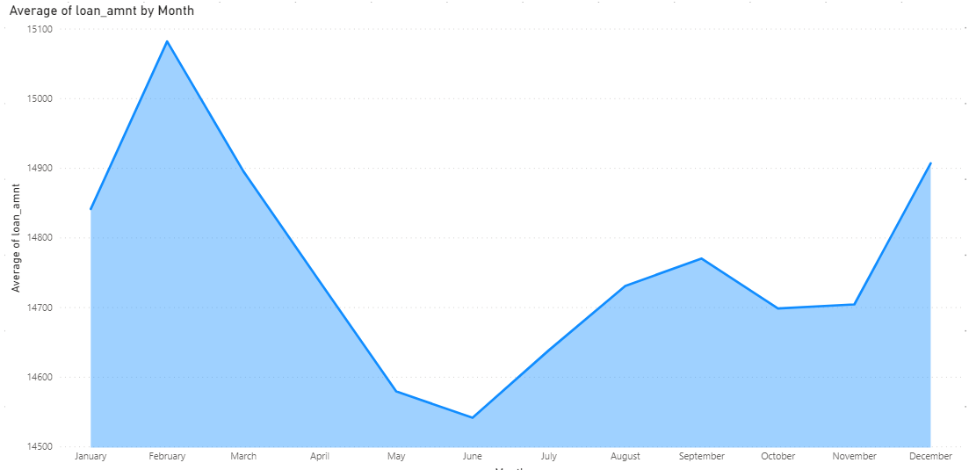
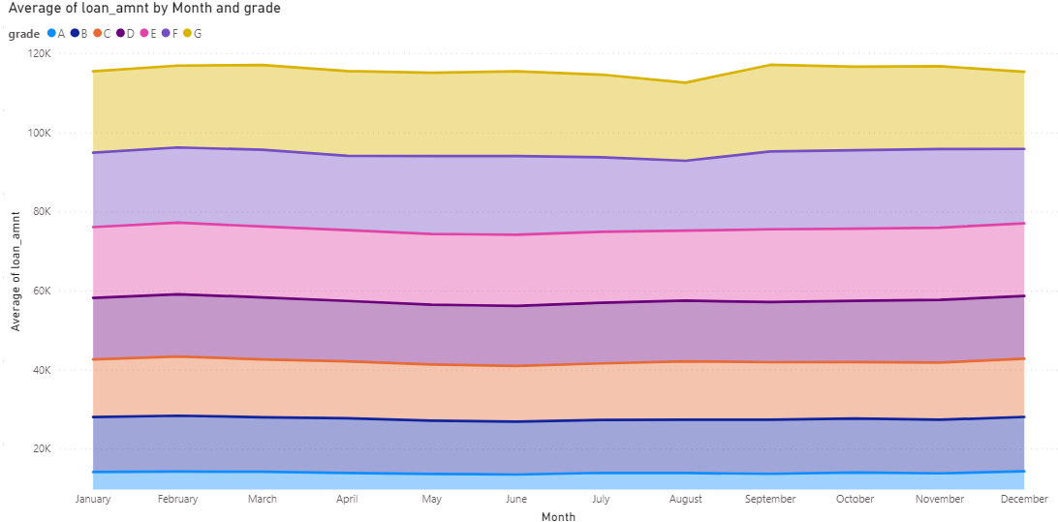
Exploratory Data Analysis:
Left graph showing loan amount by months.
Right graph showing loan amount by months and grade.

Slide 10
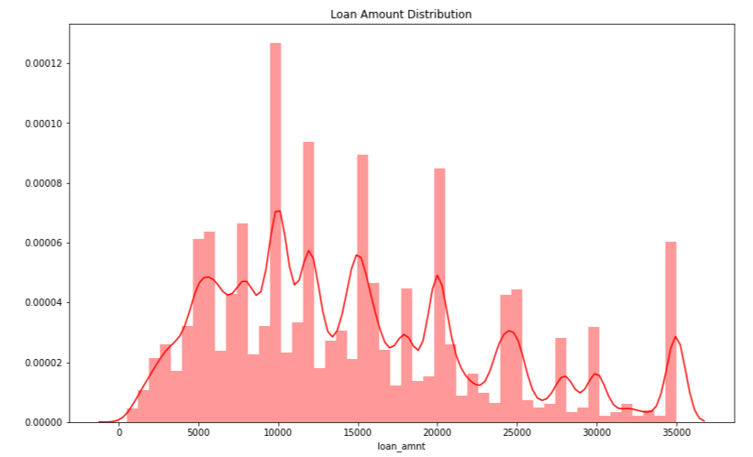
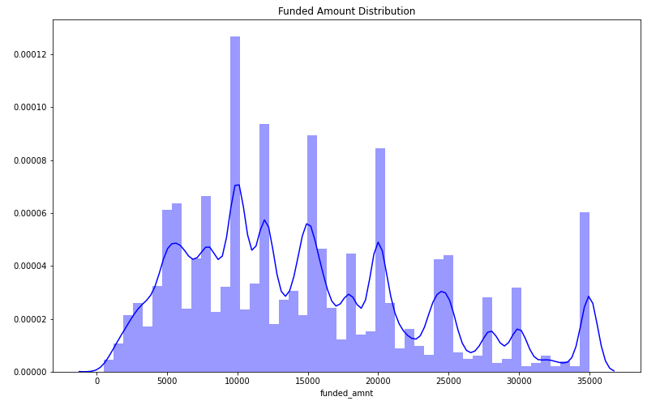
Exploratory Data Analysis:
Loan Amount Distribution
Funded Amount Distribution

Slide 11
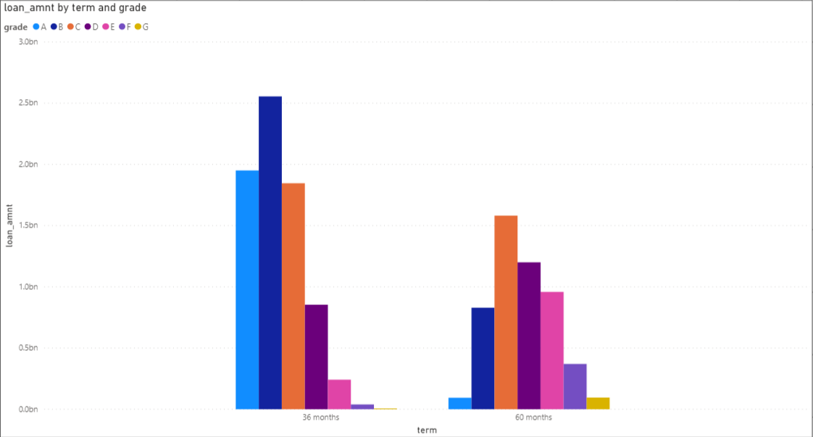
Loan Amount by Term & Grade

Slide 12
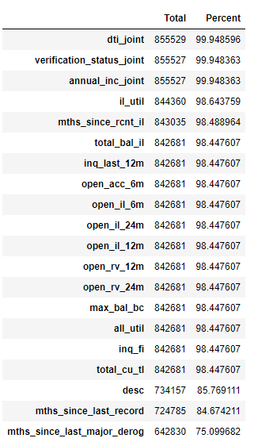
Phase I – Data Extraction and Cleaning:
Missing Value Analysis and Treatment –
We created a function to calculate missing values by percentage.

Slide 13
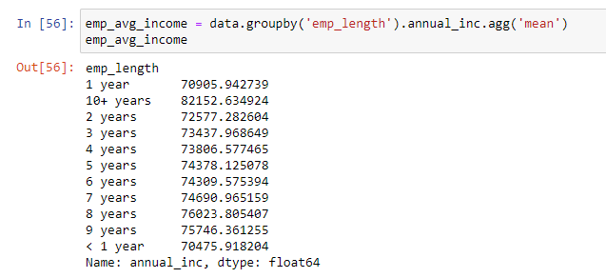
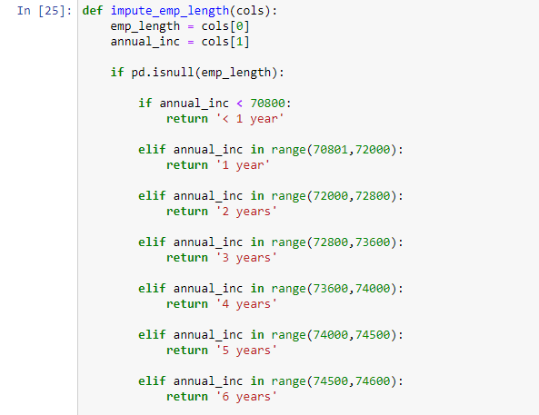
Missing Value Imputation
Here we have 43,061 missing values in the "emp_length" variable.
Assuming that "emp_length" is directly proportional to "annual_inc", average income for all the classes of "emp_length" is shown above using groupby.
Income Ranges were set for all the classes of "emp_length" according to the average values and the missing values of "emp_length" will be imputed if the class falls in a particular range that is mentioned.

Slide 14
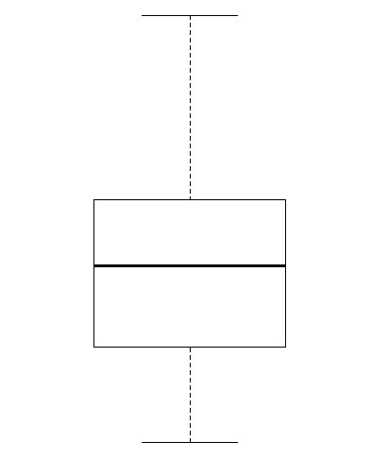
Max value
9500000
157500
90000
65000
45000
0

Slide 15
Max value
9500000
e
157500
d
90000
c
65000
b
45000
a
0

Slide 16
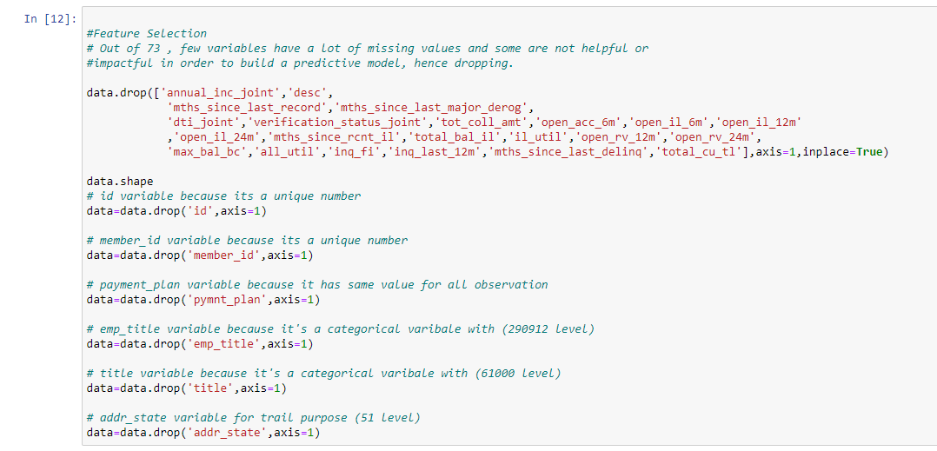
Feature Selection
Selecting features which are relevant for prediction and removing those with high percentage of missing values

Slide 17
Data Processing:
Different ways to convert categorical variables to numbers-
Dummy Variable
Label Encoding
Manual Encoding

Slide 18
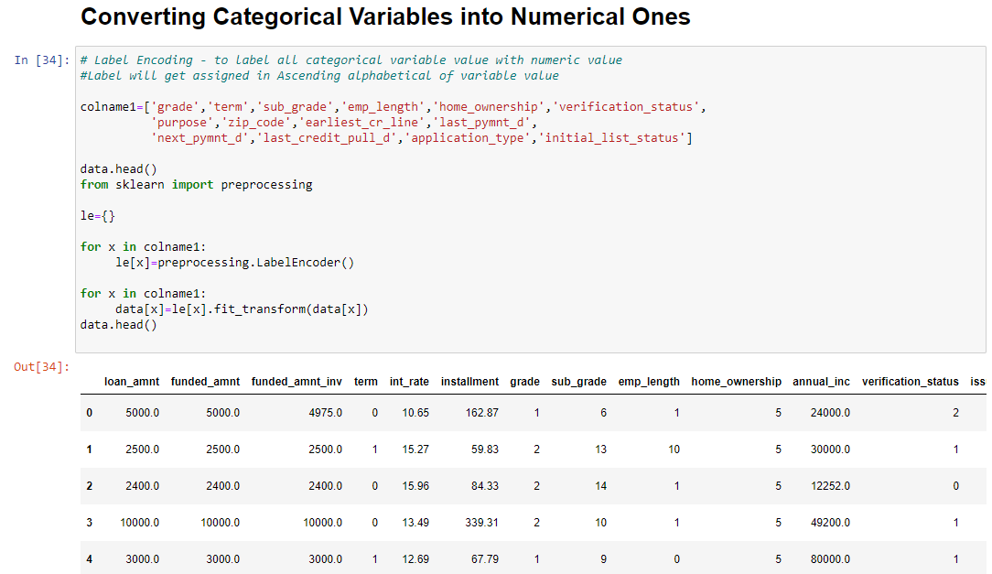
Label Encoder

Slide 19
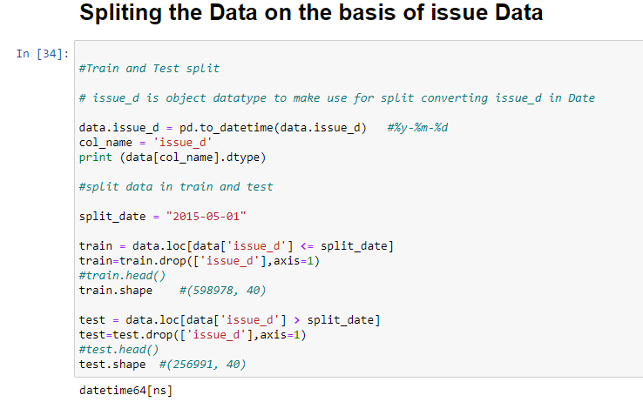
Data Partition Process
Converting the issue_d variable into datetime format to simplify the partition process.

Slide 20
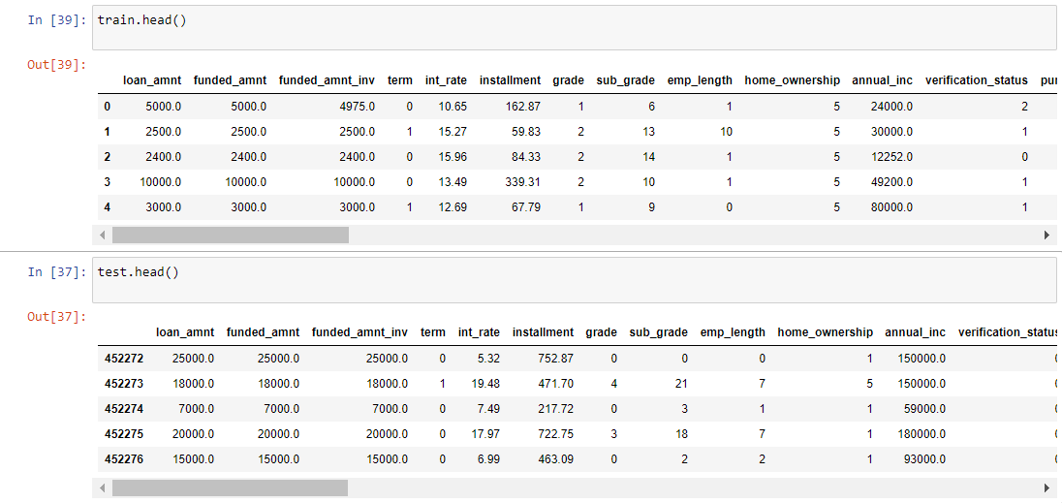
Data is divided on ‘issue_d’ variable.
Records from June-2007 to May-2015 in Training data.
Records from June-2015 to Dec-2015 in Testing data.
Followed by dropping the irrelevant column ‘issue_d’.
598978,44 is the shape of Train data.
256991,44 is the shape of Test data.

Slide 21
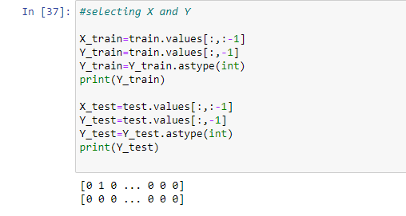
Declaring the Dependent and Independent variables

Slide 22
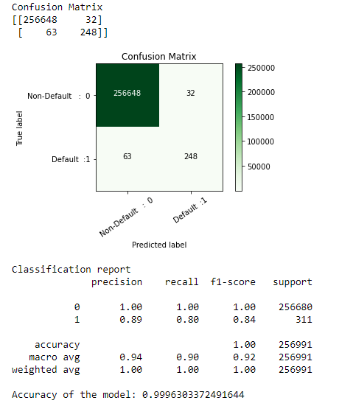
Fitting Models to Data: 1) Logistic Regression

Slide 23
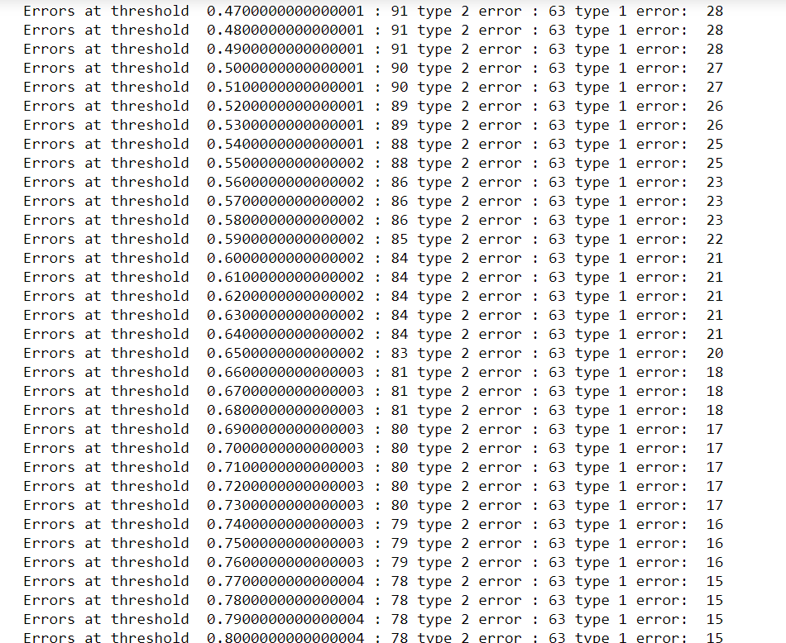
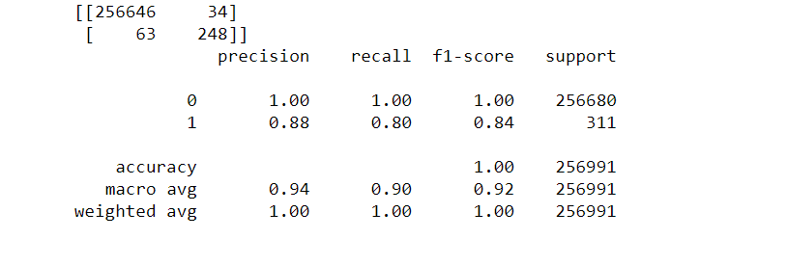
Logistic Regression After Tuning:-

Slide 24
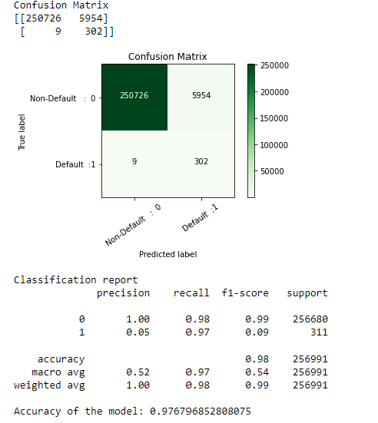
2) Decision Tree

Slide 25
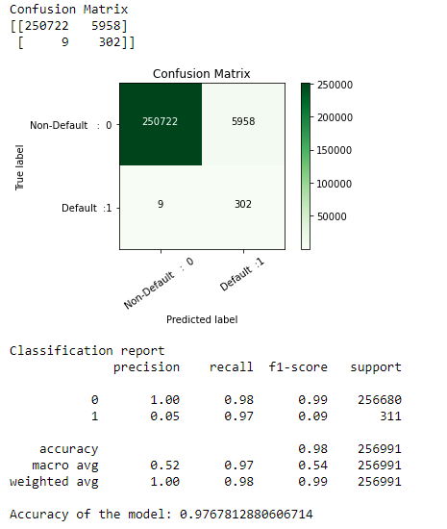
Decision Tree After Tuning

Slide 26
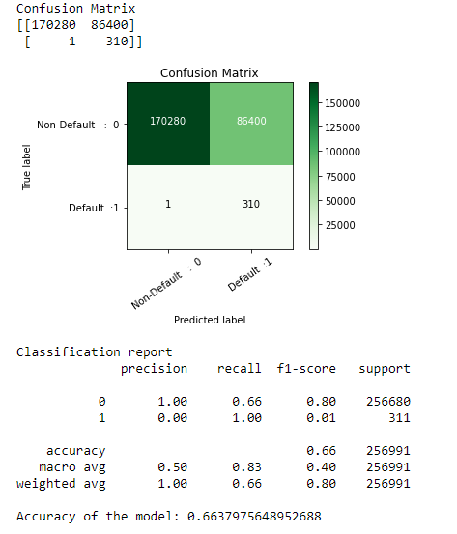
3)Random Forest

Slide 27
4) Gradient Boosting Classifier

Slide 28
5) ANN MLP Classifier

Slide 29
Final Decision:
After comparing various models, the gradient boosting classifier is the best model so far.

Slide 30
Conclusion
The results of Logistic Regression and Gradient Boosting were the best among all.
If you want low type 1 error, use Logistic Regression.
If you want low type 2 error, use Gradient Boosting.
Type 2 error are actual losses for the company and type 1 error are failed profit.
As type 2 error is dangerous in our case, we preferred using Gradient Boosting.

